Slide 1
Big Mountain Resort: Optimizing Ticket Value
New chair lift installed, increasing operating costs by $1,540,000 in upcoming season
Data driven pricing strategy to maximize profits
Which aspects of a park determine it’s supportable ticket price?
Changes to the Park that will increase ticket value

Slide 2
Recommendations & Findings
With no further changes to the park’s features, a ticket price increase is recommended, with a maximum of around $94 (15% increase)
New park construction should focus on variables revealed to most influence ticket value (number of runs/chairs, area covered by snow making machines, highest vertical drop etc.)
The park could safely shut down 1 or multiple runs without significantly decreasing ticket price

Slide 3
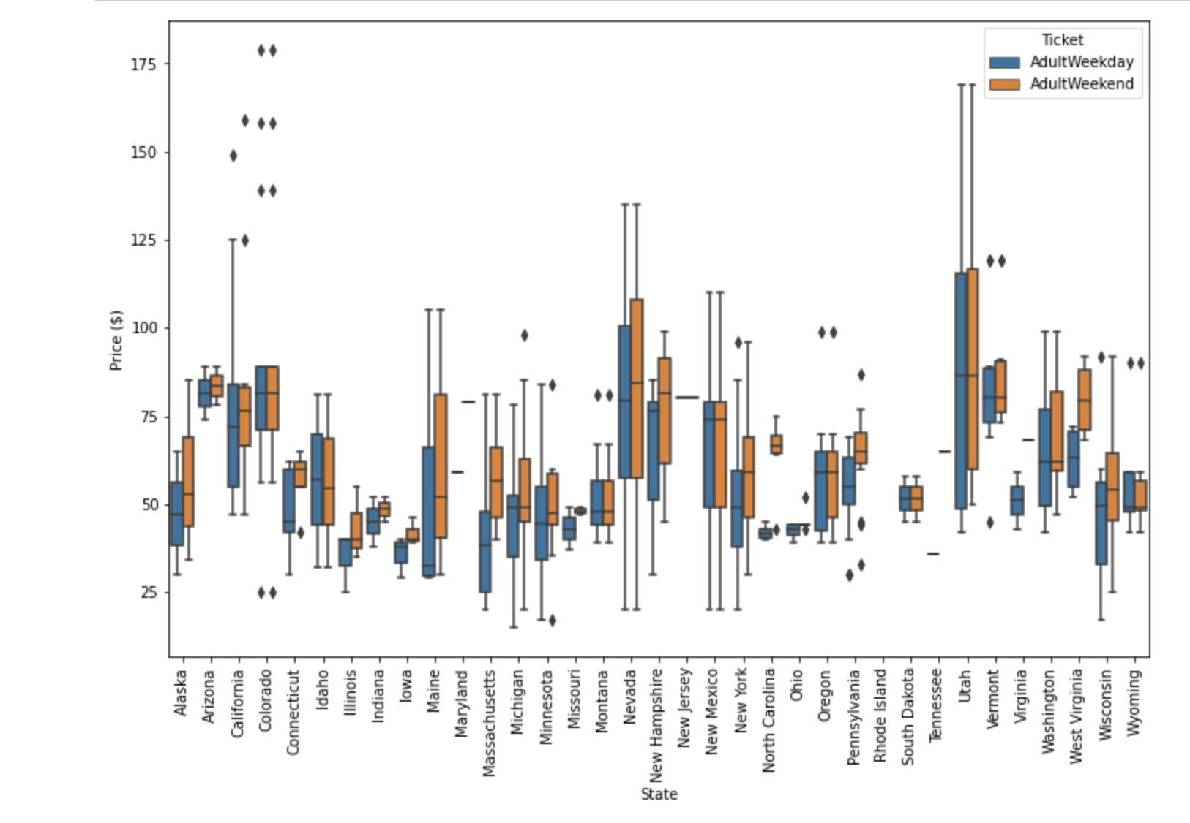
The Data
330 Ski Resorts
Ticket Price
Location
Runs & lifts
Distance/Height
Area
Hours
Types of Skiing

Slide 4
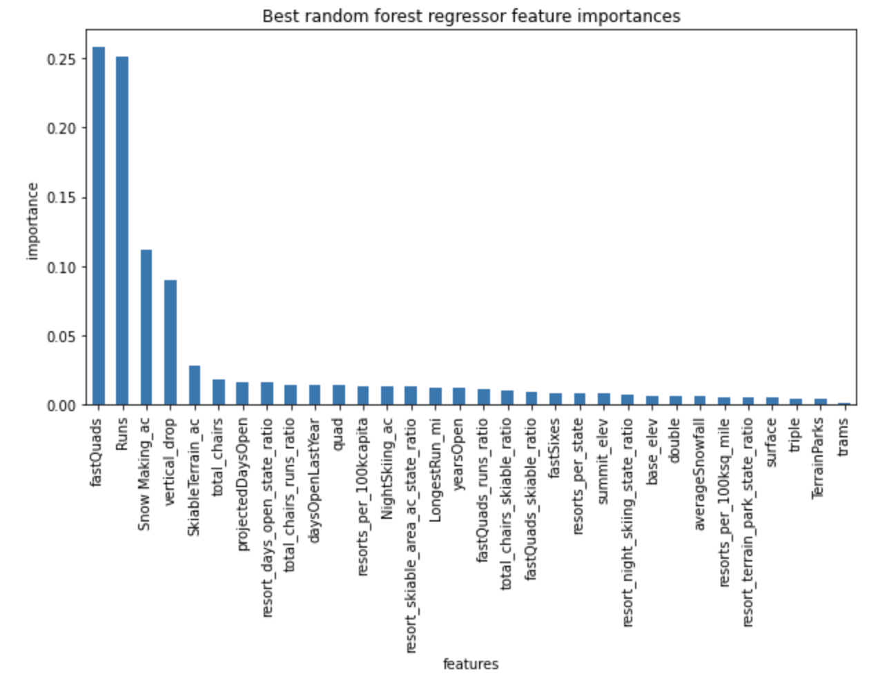
Top Resort Features
# of Fast Quad Lifts
# of Runs
Area covered by Snow Machines
Biggest drop
Skiable area
# of Charlifts
Days open

Slide 5
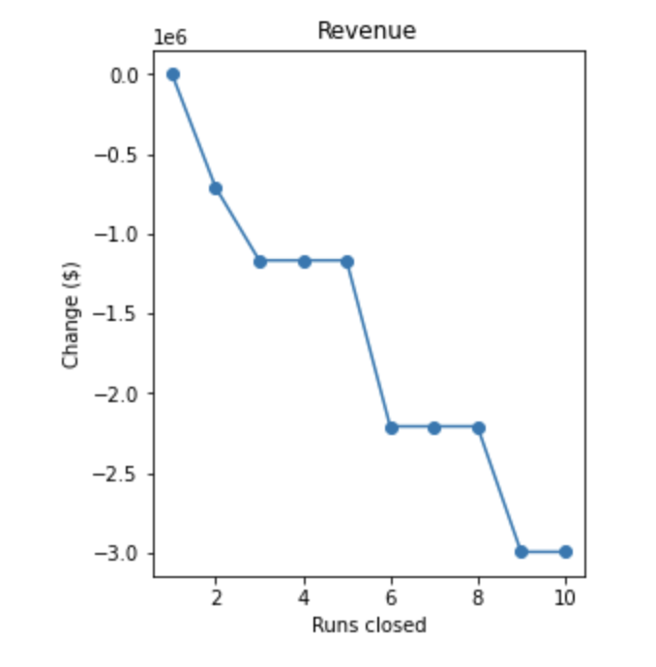
Conclusion
Big Mountain ranks in the upper quartile for all of the important resort features
Suggests a higher supportable ticket price
Shutting down runs may be increase margins

